Slide 1
St. John’s private equity competition
Dylan Bassett, Vallabh Baldwa, Zachary Epstein, Connor Valenti

Slide 2
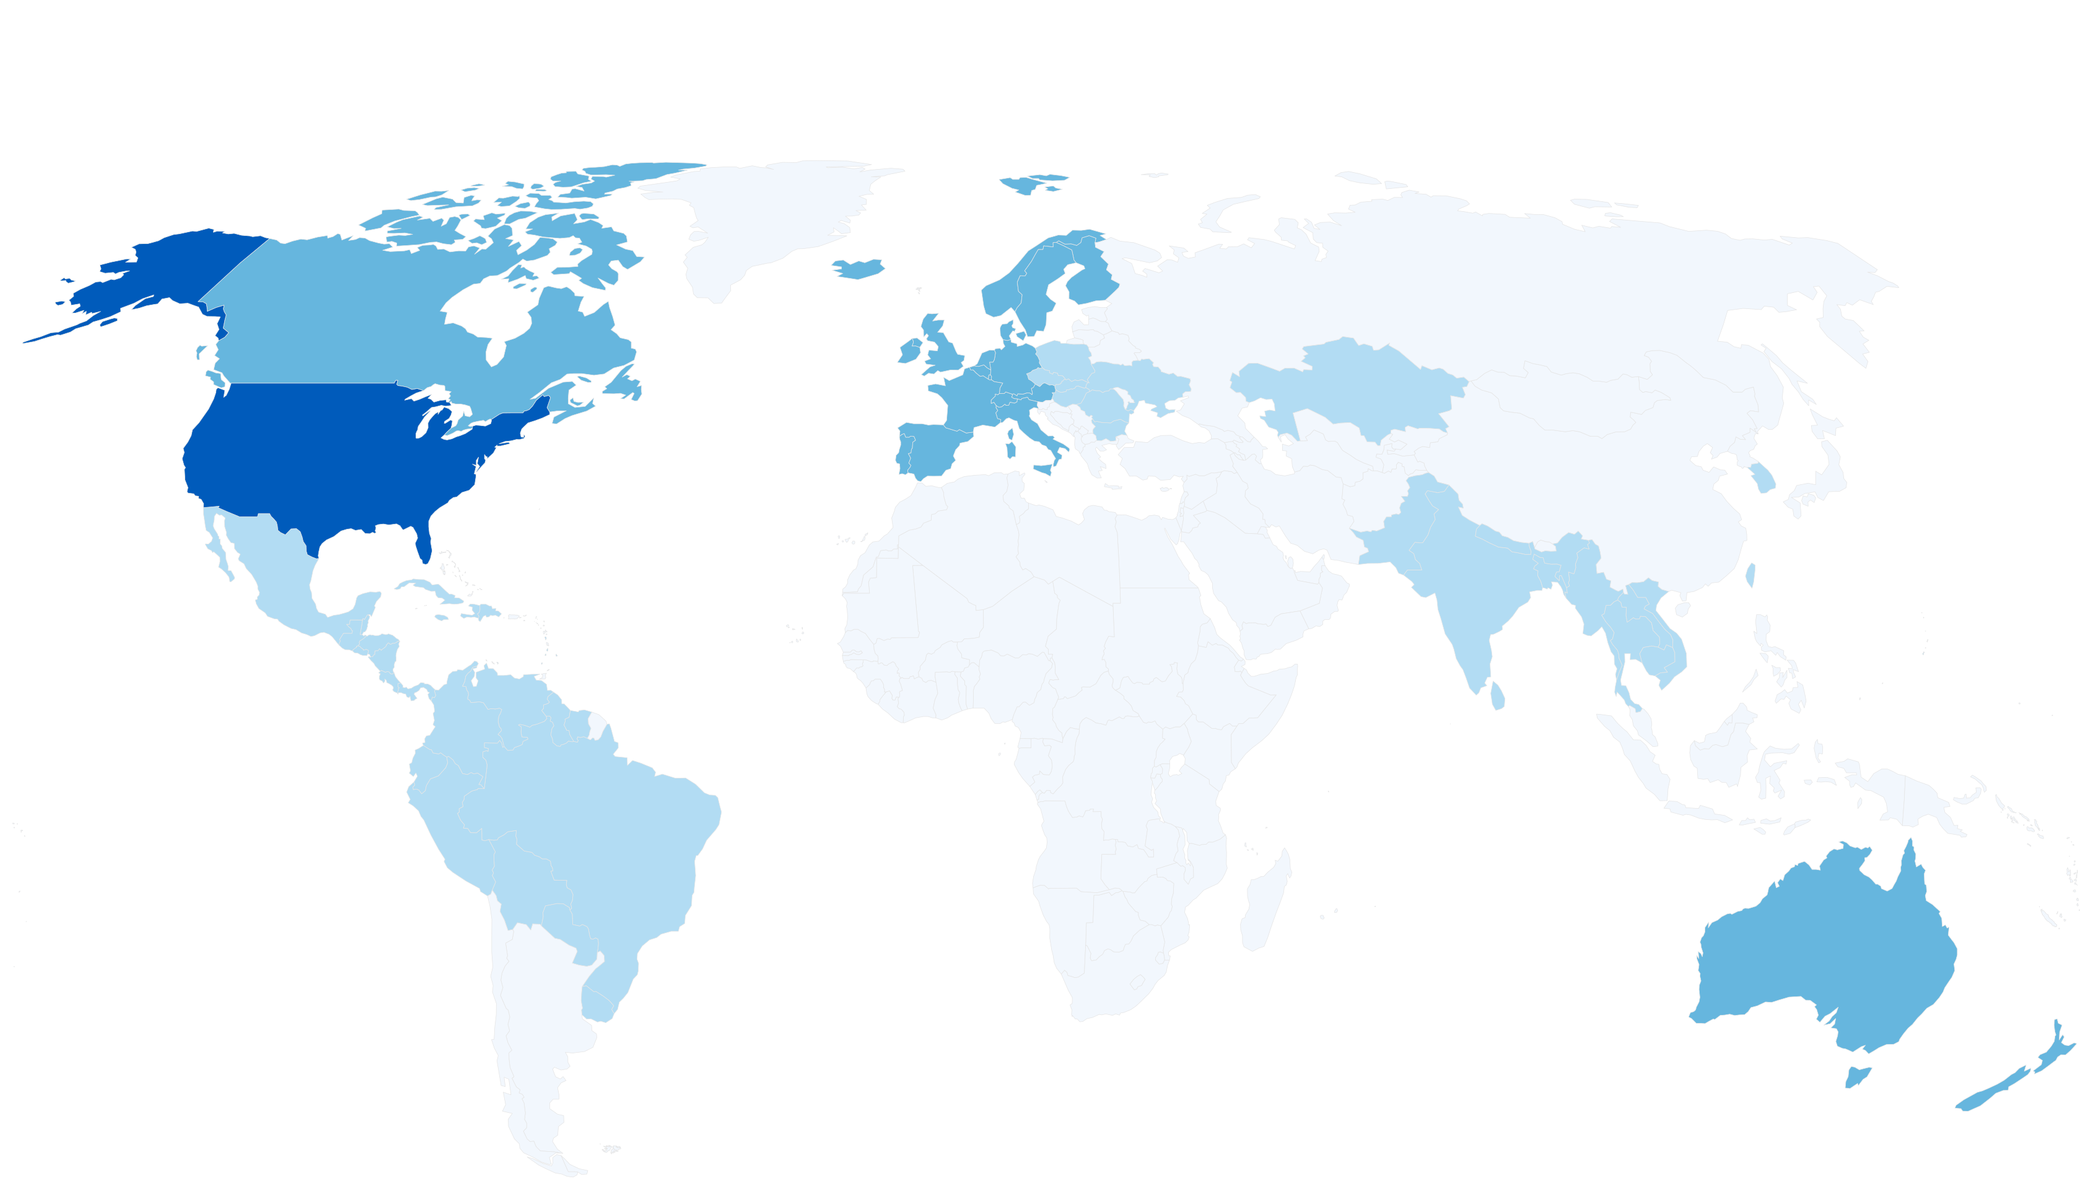
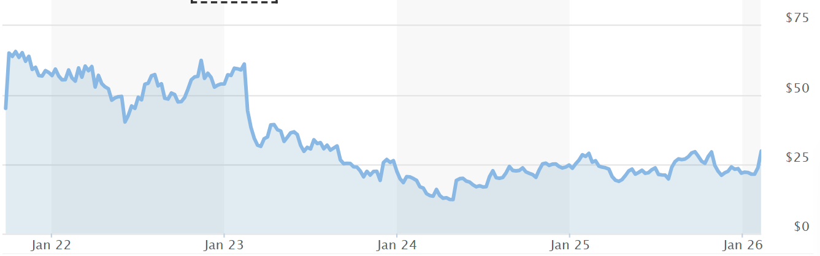
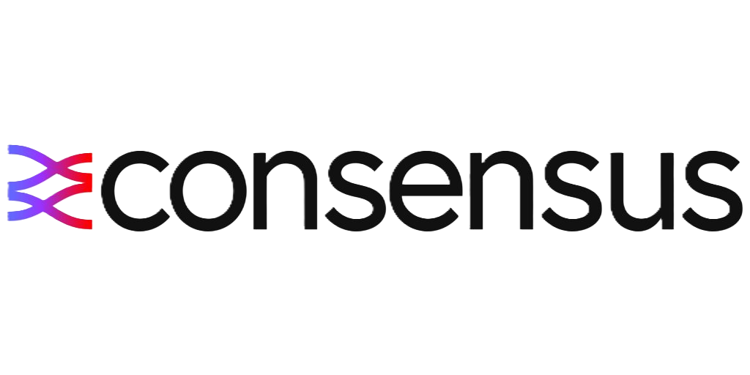
World leader in secure cloud fax and digital communication providers.
Consensus serves ~800,000 customers in ~46 countries across regulated industries (healthcare, government, financial services, legal, education, etc.) with a scalable SaaS platform.
Market Cap | Enterprise Value (EV) | P/E Ratio (TTM) | Revenue (TTM)
~$513 M | ~$1.04 B | ~6.07x | ~$350 M
Net Income (TTM) | EBITDA (TTM) | EBITDA Margin | Net Margin
~$84 M | ~$187 M | ~48–50% | ~23–25%
2000s
J2 builds cloud fax empire (eFax)
2021 (Jul)
Prospective announced
2021 (Oct)
Listed on the NASDAQ
*Note: Shading reflects relative market penetration by region, not absolute customer presence
Notes:
Legacy Overhang: Originally distributed to Ziff Davis shareholders (80.1% of float), the current cap table has since consolidated into 'Exit-Oriented' institutional hands.

Slide 3
Cloud Fax = Critical Healthcare Infrastructure
What Cloud Fax Is | Regulated document exchange embedded in healthcare workflows.
How It Works | Like email, uploads, secured msg.
Why Fax Still Exists | Explicitly recognized under HIPAA. Universally interoperable across providers
Why Email Is Not a Substitute | Not HIPAA-compliant. Requires encryption coordination.
INPUT
Embedded Cloud Fax Transmission
• No manual handling
• API / workflow integrated
• Invisible to staff
COMPLIANT INFRASTRUCTURE
Secure, Regulated Transmission Layer
• Encrypted end-to-end
• HIPAA-aligned
• Timestamped + logged
• Delivery confirmation
UNIVERSAL DELIVERY
Accepted by Any Counterparty
• Insurers
• Labs
• Specialists
• Government agencies
• Digital or physical endpoint
EHR-Generated Medical Record
• Triggered as part of routine workflow
AUTOMATED ROUTING
Record uploaded
Record sent via cloud fax
Document is:
Encrypted
Sent via cloud servers
Logged w/ timestamps + confirmation
Specialist receives it:
In a legally accepted format
As a fax (digital or physical)
Notes:
Walkthrough from doc

Slide 4
Regulation-Driven Customer Stickiness
Regulated Infrastructure
Healthcare communication is HIPAA-governed
Compliance enforced at the workflow
Approval Creates Switching Costs
Vendor onboarding requires formal compliance review
Re-approval is operationally disruptive
Why Customers Stay
Systems are already compliant and trusted
Switching introduces regulatory and workflow risk
Implications
Low churn driven by regulatory inertia rather than pricing Predictable, recurring cash flows Limited CapEx Supports leverage and steady, natural deleveraging Earnings profile suitable for multiple expansion

Slide 5
Ownership Rationale & Transaction
Current Landscape
Institutional Grip: Over 93% of shares are held by professional institutions; the retail public float is essentially negligible.
Why They Sell
Immediate Liquidity at Scale: Large-block holders cannot exit a position of this size in the open market without suppressing the price; a buyout offers 100% liquidity at a fixed premium.
Active Decision-Makers: ~37% of voting power is concentrated among just 5 active value committees (Janus, Gates, etc.).
The Passive Floor: ~20% of ownership is held by indexers (Vanguard/BlackRock) who historically follow market-leading premiums.
Disinterested Legacy Overhang: Much of the base consists of "accidental" owners from the 2021 Ziff Davis spin-off who are facing "spin-off fatigue" after years of range-bound trading.
C-Suite Re-Incentivization: With insider ownership at only 2.25%, a 20% premium creates a $2.3M+ immediate cash-out for the team, while allowing them to "roll over" into a much larger private equity incentive pool.
Company | Shares Owned | %
Janus Henderson | 2,476,328 | 13.03%
The Vanguard Group | 1,647,550 | 8.69%
BlackRock | 1,382,137 | 7.29%
Gates Capital | 1,371,014 | 7.22%
Insider Ownership (DEF 14A)
Forward Looking Volume Trend
99.4% Locked
We are here
Source: Nasdaq Institutional Holdings, Bloomberg, Management Estimates.

Slide 6
Market Analysis, Strategic Positioning
Paper Fax
A manual, labor-intensive legacy baseline that represents a high-friction "un-digitized" market ripe for cloud disruption.
Legacy Digital
Hardware-dependent on-premise servers that lack the scalability and AI-driven interoperability of modern SaaS platforms.
Cloud Fax
The mission-critical SaaS frontier where CCSI commands a dominant 60% share of all modernized healthcare document exchange.
Company | Market Cap | EV/EBITDA
OpenText | $9.4B | 8.13x
RingCentral | $2.6B | 7.82x
Consensus | $517M | 5.6x
Upland | $28.4M | 4.12x
Healthcare Comm. Industry Breakdown
OpenText
(~25%)
A legacy hardware-focused incumbent struggling to migrate its aging on-premise fax server clients to the modern cloud.
RingCentral (~10%)
A generalist phone and video provider that treats healthcare fax as a basic, low-priority software add-on.
Upland (<5%)
A small-scale software aggregator lacking the specialized features and security needed for large hospital systems.
60% Market Share

Slide 7
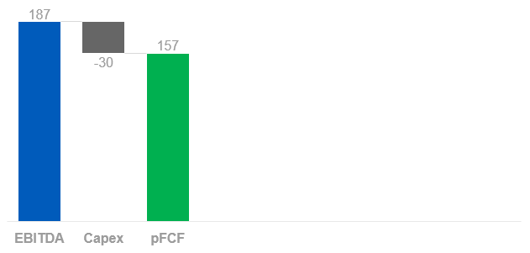
Cash Flow-Funded Network Expansion
~84% Cash Conversion
Private Ownership Advantage
Eliminate Public Markets Costs: Remove ~$4M in public company overhead.
Shift from EPS Stability to Strategic Investment: Execute multi-year margin compression without quarterly earnings pressure.
Strategic Market Penetration
Intentional Margin Reinvestment: Temporarily reinvest into expanded sales coverage to accelerate penetration.
Density Over Margin: Prioritize network touchpoints over near-term profitability.
Capital Deployment
Phase I (2026–2028): Prioritize growth reinvestment over accelerated deleveraging.
Phase II: Utilize increased scale & cash flow to optimize capital structure.
Long-Term: Exit as healthcare intelligence platform.
$350M
FY25 Revenue
64% Corporate
Sticky Healthcare + Gov Rev (+6.5% YoY); Corporate revenue retention rate of 101.3%
Notes:
We have the cashflows to support a shrinkage of margin; private equity takes initiate and shrinks their margins in the short term when they can’t be punished by shareholder.

Slide 8
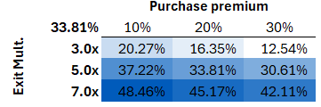
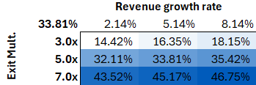
Public to Private Acquisition
Leveraged Buyout
Debt Paydown
Millions
Total Debt | $944.23
Net Debt/’26 EBITDA | 5.10x
Implied Rating | B / B2
SOFR | 3.65%
Spread (B Rating) | 4.75%
Entry Assumptions
Entry Multiple: 5.58 EBITDA
Enterprise Value: $1041.74
Equity Contribution: $254.82M (~40%)
Debt Financing: $382.23 (~60%)
Entry Leverage: $186.67M EBITDA
(2026–2028) PHASE I: Privatize & Penetrate
(2028–2029) PHASE II: Roll-Up & Network Expansion
(2030-2032) PHASE III: Data Monetization & Expansion
(2032) EXIT
Notes:
TALK ABOUT THE DEBT STRUCTURE, WHERE WE GET THE DEBT, HOW WE GOT THERE
B2 rating → 9% lending from banks
Purchase price vs exit price
Bar chart debt going down

Slide 9





Exit Outlook
Entry
Health Care “Telecom/Fax Utility”
Exit
Health care “Business Intelligence” Hub
Buyer Type | Why | Buyer
Big Tech / AI | Needs the "unstructured data" pipeline to fuel their medical LLMs and AI diagnostic tools.
Healthcare ERPs (Enterprise Resource Planning) | Wants to own the "Intelligence" layer that connects disparate hospital systems.
$1.1B Exit / $637M Entry
Investor Returns
2032P Revenue: $464.2M
2032P Gross Profit: $371.36M
2032P Net Income: $140.08M
33.81% IRR
4.3x MOIC

Slide 10
St. John’s private equity competition
Dylan Bassett, Vallabh Baldwa, Zachary Epstein, Connor Valenti

Slide 11
St. John’s private equity competition
Dylan Bassett, Vallabh Baldwa, Zachary Epstein, Connor Valenti

Slide 12
World leader in secure cloud fax and digital communication providers.
Consensus serves ~800,000 customers in ~46 countries across regulated industries (healthcare, government, financial services, legal, education, etc.) with a scalable SaaS platform.
Market Cap | Enterprise Value (EV) | P/E Ratio (TTM) | Revenue (TTM)
~$513 M | ~$1.04 B | ~6.07x | ~$350 M
Net Income (TTM) | EBITDA (TTM) | EBITDA Margin | Net Margin
~$84 M | ~$187 M | ~48–50% | ~23–25%
2000s
J2 builds cloud fax empire (eFax)
2021 (Jul)
Prospective announced
2021 (Oct)
Listed on the NASDAQ
Notes:
Legacy Overhang: Originally distributed to Ziff Davis shareholders (80.1% of float), the current cap table has since consolidated into 'Exit-Oriented' institutional hands.

Slide 13
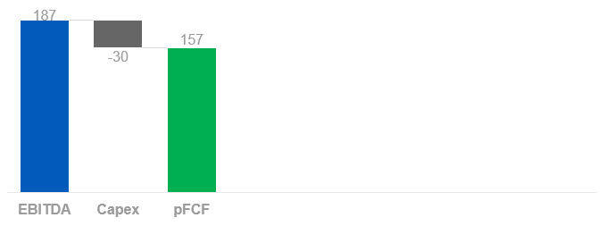
“The Price of Freedom” – Investment Opportunity
Legacy Burden
The Unlock
The $800M (Currently $562M) debt is a "Price for Freedom" from the Ziff Davis spin-off that forces Consensus to act as a Cash Cow rather than a Growth Platform.
Private ownership removes the 90-day earnings pressure, allowing us to redirect Free Cash Flow.
Market Cap | Enterprise Value (EV) | P/E Ratio (TTM) | Revenue (TTM)
~$513 M | ~$1.04 B | ~6.07x | ~$350 M
Net Income (TTM) | EBITDA (TTM) | EBITDA Margin | Net Margin
~$84 M | ~$187 M | ~48–50% | ~23–25%
Current Net Debt / EBITDA: 3.01x
Exit Net Debt / EBITDA: 1.6x
Millions
Untapped growing potential

Slide 14
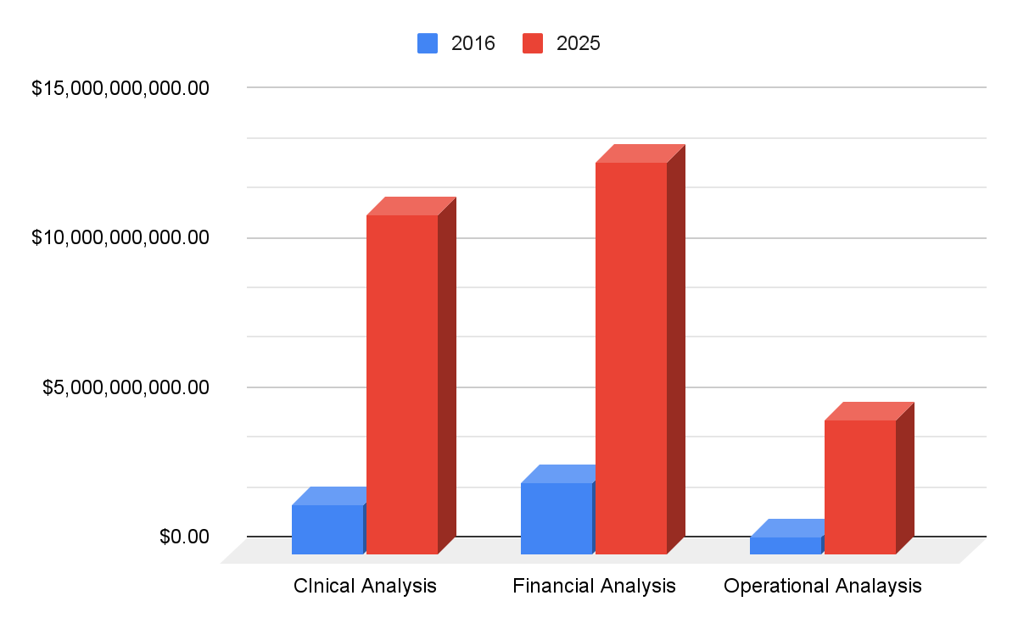
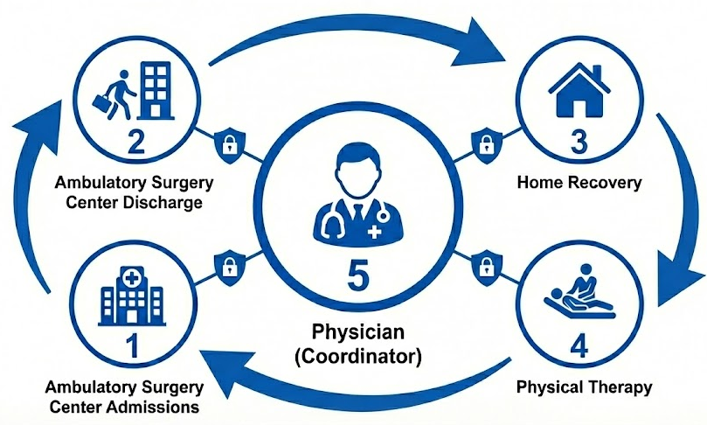
The 3-Phase Value Creation Plan
From Cash-Flow Utility to Healthcare Intelligence Platform
CCSI Is Not a Fax Company. It’s a Network
Tomorrow: We operate one of the largest healthcare communication networks.
Today: We move documents and get paid per transaction.
At scale, data becomes intelligence. Processing billions of healthcare transactions annually, CCSI has the scale to generate actionable insights. McKinsey estimates that clinical big data analytics alone could drive over $300 billion in annual savings in the U.S. healthcare system
Notes:
Clinical Analytics: $300B Can be Saved by the US Annually Using Big Data Analytics (McKinsey)

Slide 15
CCSI Is Not a Fax Company. It’s a Network.
1
Expand sales.
Prioritize network density.
Temporarily compress margins to accelerate penetration.
2
Integrate adjacent workflows.
Increase revenue per account.
Deepen contract relationships and raise switching costs structurally.
3
Aggregate anonymized workflow-level data across billions of transactions.
Generate insights on referrals, prior authorizations, and revenue cycle friction.
Build high-margin intelligence and automation products.
Phase I (2026–2028): Privatize & Penetrate
Phase II (2028–2031): Roll-Up & Network Expansion
Phase III (2030+): Intelligence Layer & Strategic Repositioning
Increase R&D to deepen workflow integration.
Cross-sell into an embedded, high-retention base.
Workforce Transformation Overview
EBITDA margin dips in ‘26–’27
Revenue steadily grows
IRR turns positive in 2028
IRR compounds to 33%+ by exit

Slide 16
Buyout Transition & Incentive Alignment Plan
Strategic Recapitalization of Management
Alignment: Currently, the C-Suite has "low-skin" exposure
Re-Investment Mandate: Require a mandatory rollover of 50–100% of any transaction-related bonuses or "change in control" payments into NewCo equity
Wealth Creation Hook: Transition the C-Suite from a "Cash-Comp" mindset (Salary/Bonus) to a "Capital-Gains" mindset (Equity Appreciation)
We will establish a Management Equity Pool (MEP) of 10–12%, structured as "Strip Equity" to mirror the Sponsor's risk/reward profile.
Incentive Bucket | What | Why
1. Retention (25%) | Vests over 5 years. | Ensures the CEO doesn't leave mid-turnaround.
2. Operations (25%) | Vests on EBITDA targets. | Rewards the "heavy lifting" of improving the business.
3. Home Run (50%) | Vests on Investor Returns. | Only pays out if the PE firm makes 2.0x–3.0x their money.

Slide 17
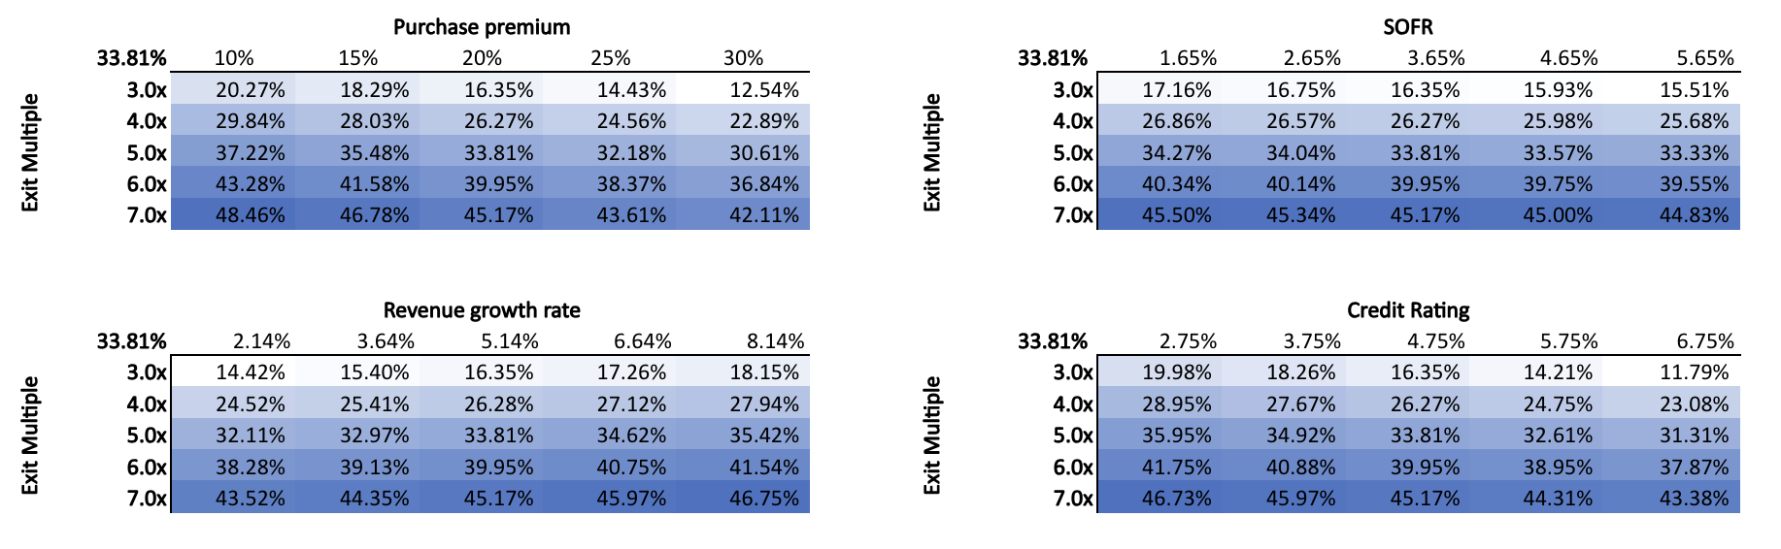
Internal Rate of Return (IRR) Sensitivity Analysis

Slide 18
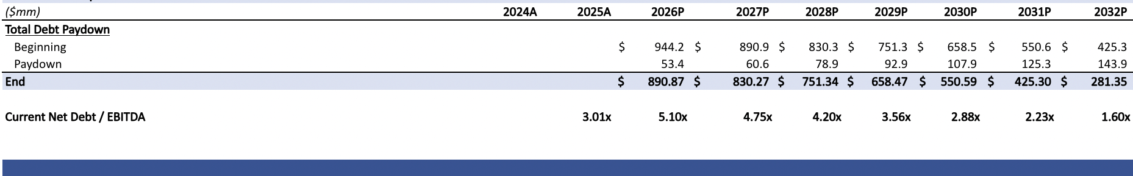
Debt Structure
Benchmark (SOFR): 3.65%
Credit Spread: 4.75%
All-in Cost of Debt: 8.40%
S&P / Fitch Rating: B
Moody’s Rating: B2
Debt Paydown
Millions

Slide 19
Ownership Rationale & Transaction
Current Landscape
Institutional Grip: Over 93% of shares are held by professional institutions; the retail public float is essentially negligible.
Why They Sell
Immediate Liquidity at Scale: Large-block holders cannot exit a position of this size in the open market without suppressing the price; a buyout offers 100% liquidity at a fixed premium.
Active Decision-Makers: ~37% of voting power is concentrated among just 5 active value committees (Janus, Gates, etc.).
The Passive Floor: ~20% of ownership is held by indexers (Vanguard/BlackRock) who historically follow market-leading premiums.
Disinterested Legacy Overhang: Much of the base consists of "accidental" owners from the 2021 Ziff Davis spin-off who are facing "spin-off fatigue" after years of range-bound trading.
C-Suite Re-Incentivization: With insider ownership at only 2.25%, a 20% premium creates a $2.3M+ immediate cash-out for the team, while allowing them to "roll over" into a much larger private equity incentive pool.
Company | Shares Owned | %
Janus Henderson | 2,476,328 | 13.03%
The Vanguard Group | 1,647,550 | 8.69%
BlackRock | 1,382,137 | 7.29%
Gates Capital | 1,371,014 | 7.22%
Insider Ownership (DEF 14A)
Forward Looking Volume Trend
99.4% Locked
We are here
Source: Nasdaq Institutional Holdings, Bloomberg, Management Estimates.

Slide 20
Precedent Transactions
Market Premiums for Healthcare Intelligence Platforms
Target Company | Cerner | Change Healthcare | Nuance | Intermedix
Acquirer | Oracle | Optum | Microsoft | R1 RCM
Logic | Network & System Interoperability | Intelligence & Workflow Integration | Unstructured Data Transition | Business Intelligence Pivot
Enterprise Value | $28.3B (Jun-22) | $13.0B (Oct-22) | $19.7B (Mar-22) | $0.5B (Apr-18)
EV / EBITDA (or Rev) | ~20.0x | ~18.0x | ~14.0x (Rev) | ~15.0x
Industry Peer Group | Legacy Telecom / Managed Services | Healthcare IT / Data Intelligence
Typical EV / EBITDA Multiple | 6.0x – 8.0x | 14.0x – 20.0x

Slide 21
Customer Network
From Fax to "Unite": Every existing customer on our map is a potential node. As more hospitals join, the network value grows exponentially.
Global Interoperability: By standardizing data extraction (AI/OCR) across the globe, Consensus becomes the "universal translator" for medical records, regardless of the local language.
Dominant Market Share: High penetration in regulated industries (Healthcare, Legal, Financial Services) across North America and Europe.
The "Invisible" Infrastructure: Consensus already sits at the center of millions of daily data exchanges.
60% Market Share

Slide 22
From Utility to Intelligence
Entry
Health Care “Telecom/Fax Utility”
Exit
Health care “Business Intelligence” Hub
Buyer Type | Why | Buyer
Big Tech / AI | Needs the "unstructured data" pipeline to fuel their medical LLMs and AI diagnostic tools.
Healthcare ERPs (Enterprise Resource Planning) | Wants to own the "Intelligence" layer that connects disparate hospital systems.
$1.1B Exit / $637M Entry
Complete Transformation
The Outcome: We have successfully transitioned Consensus from a "Legacy Fax" provider to a mission-critical Healthcare Intelligence Platform.
Layered Value: Following our roadmap, we have moved from simple data transmission to AI-driven Data Extraction and Interoperability.
Network Effect: With the largest secure clinical exchange network, Consensus is now an essential "plug-in" for EMR systems and Big Tech/AI to solve real world problems.
Investor Returns
33.81% IRR
4.3x MOIC

Slide 23
St. John’s private equity competition
Dylan Bassett, Vallabh Baldwa, Zachary Epstein, Connor Valenti

Slide 24
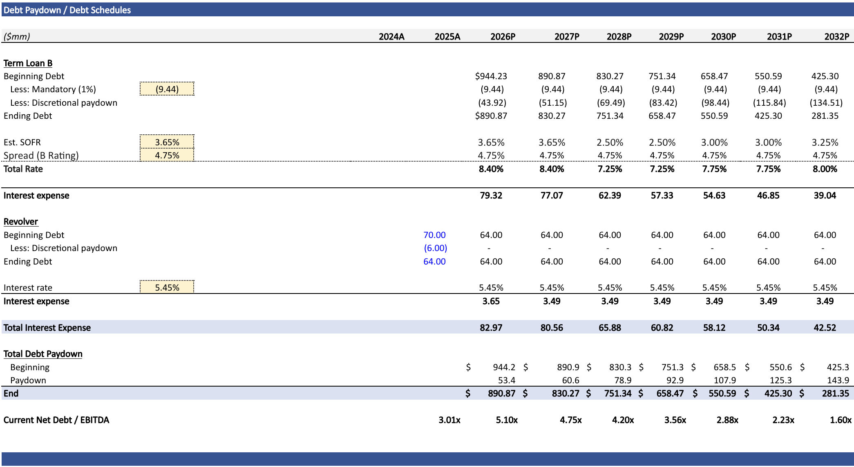
Debt Paydown / Debt Schedules

Slide 25
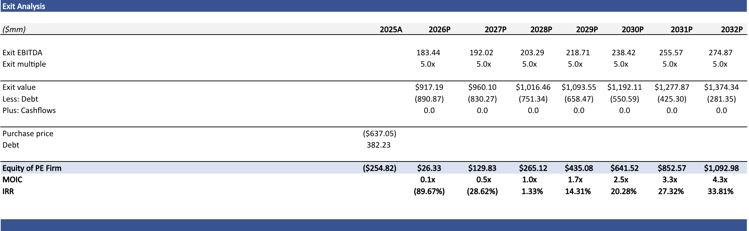
Exit Analysis

